Slide 1
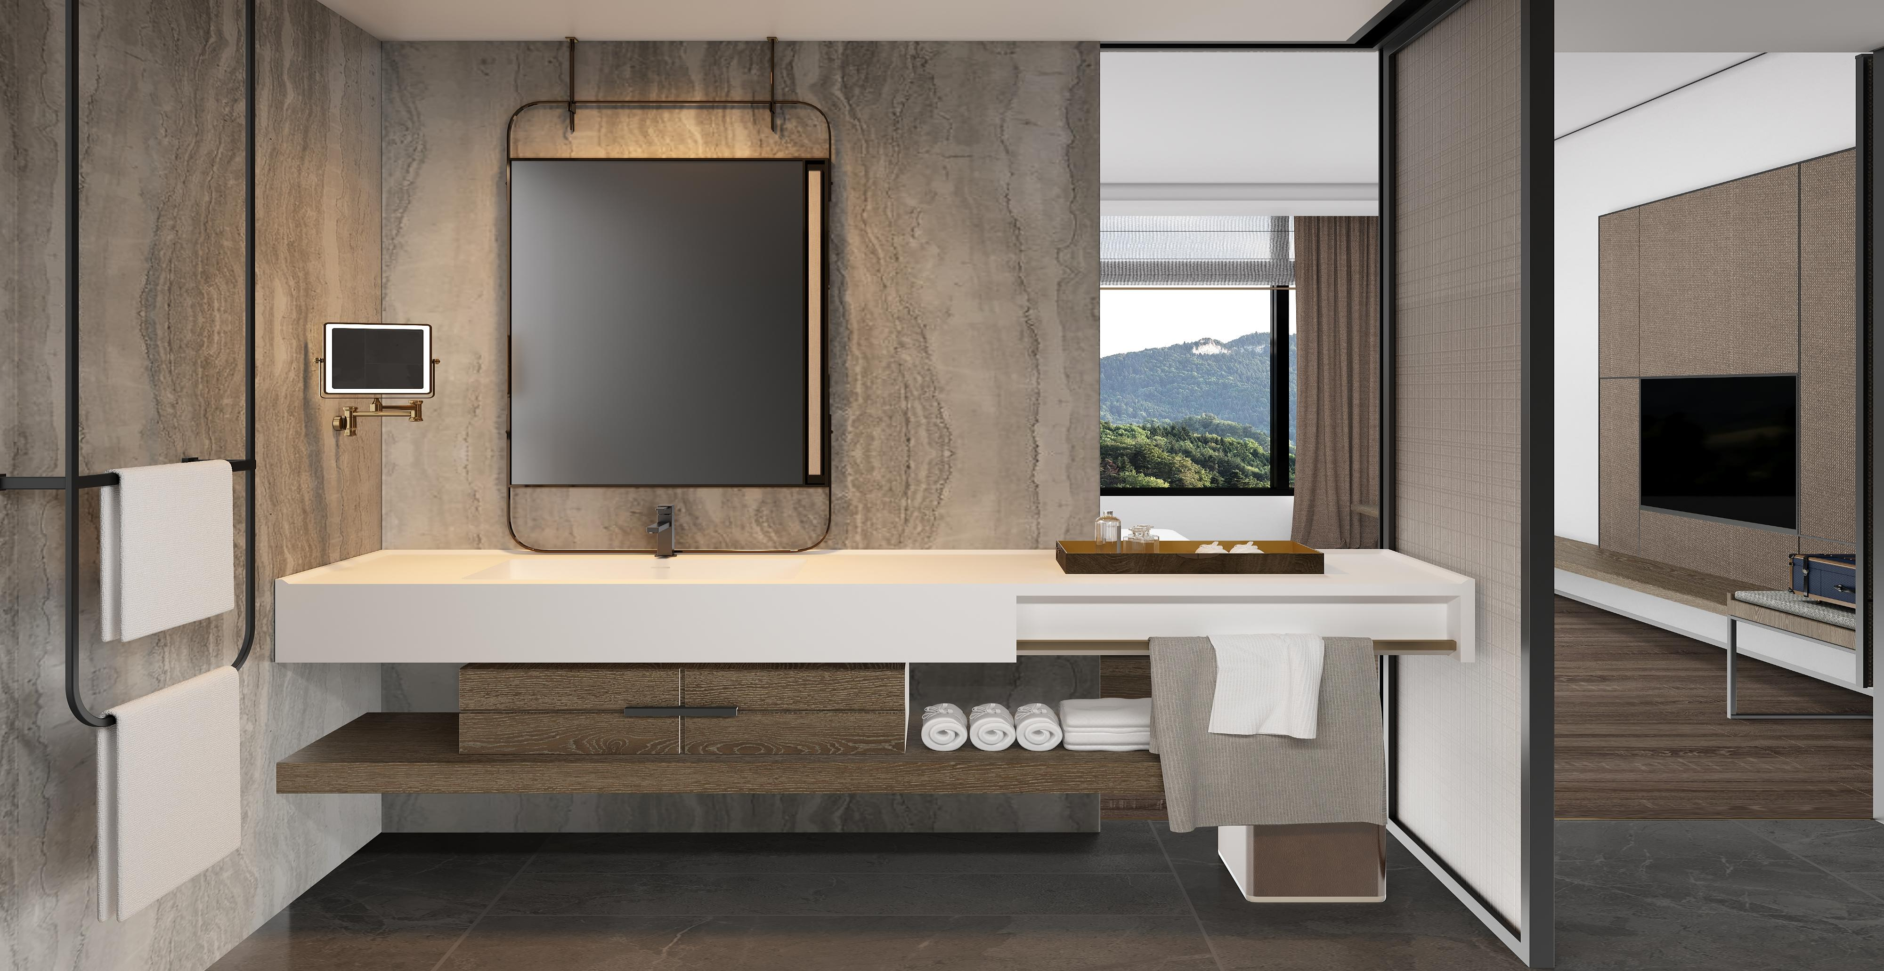
Hongdao Sanitary Ware Company Profile
Delivering excellence in solid surface sanitary ware for an enduring bathroom experience.
Notes:
Dear friends from the Graniti Vicentia team, welcome.
My name is Linda, and on behalf of HONGDAO Sanitary Ware, it is my great pleasure to have you here today.
HONGDAO specializes in solid surface and cast marble sanitary ware products, and our mission is to deliver durable, high-quality, and elegant bathroom solutions for global markets.
With many years of industry experience and strong manufacturing capability, we are confident in providing reliable products and professional service.
Next, I will walk you through our company profile so you can better understand who we are.
Now, let us begin this journey together.

Slide 2
1
Company Introduction - Who Are We?
2
Core Strengths - Why Choose Us?
CONTENTS
3
Our Products - A Premium Selection of Sanitary Ware
3
Project case - Partners Working with Us
5
Factory Showcase​ - Two Advanced Production Lines
Notes:
Today’s presentation will cover five main parts:
First, we will introduce our company—who we are.
Second, we will explain our core advantages and why clients choose us.
Third, we will showcase project cases and cooperation partners.
Fourth, we will present our two advanced production lines.
Finally, we will introduce our product range.
Step by step, this presentation will give you a complete overview of our company.

Slide 3
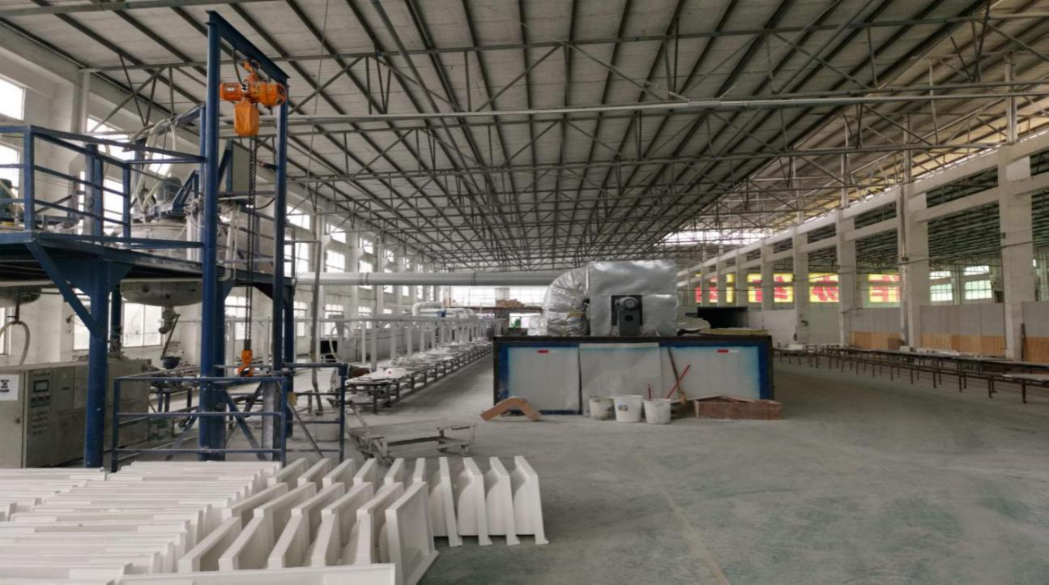
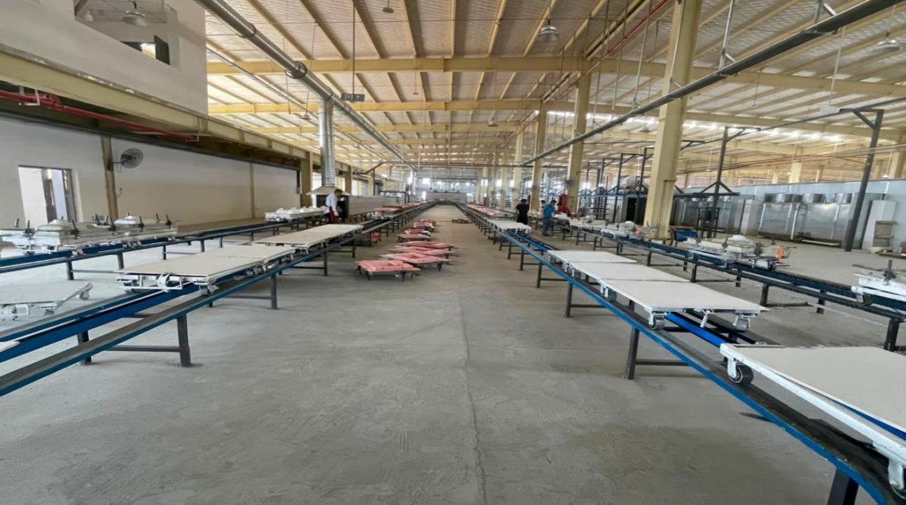
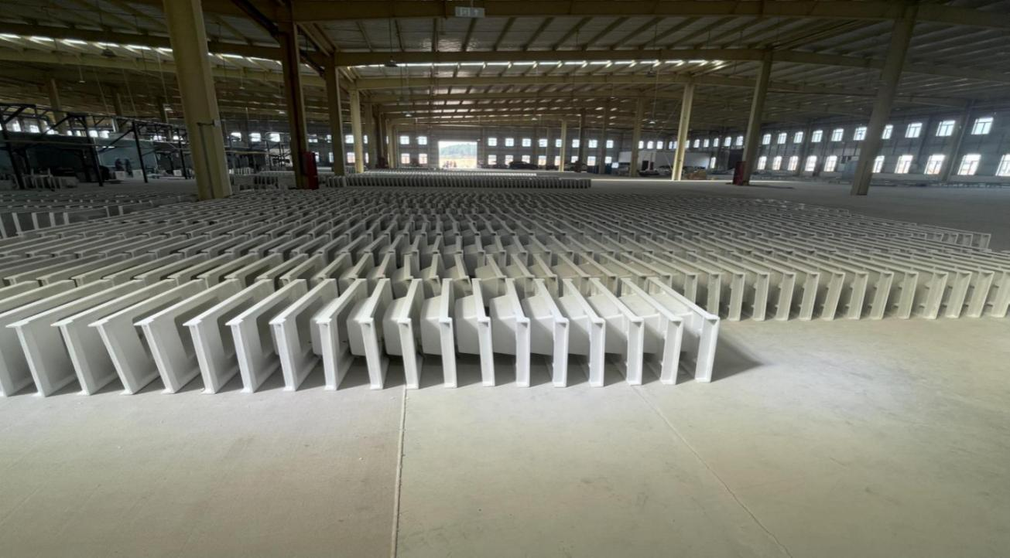
company introduction
21 Years
Industry experience
30000㎡
workshops
400,000
Annual output
With 21 years of industry expertise, Zhaoqing Hongdao Sanitary Ware Technology is a leading Chinese manufacturer specializing in the R&D, production, and sales of solid surface sanitary ware. We have a strong global presence, exporting our products to more than 10 countries across Europe, North America, Australia, the Middle East, and Southeast Asia.
HONDAO specializes in the R&D and production of sanitary ware, with two core material systems: acrylic solid surface and artificial stone gel-coat. Leveraging industry-leading manufacturing capabilities, we provide global customers with a diverse range of products, including bathtubs, wash basins, kitchen sinks, shower bases, and wall panels.
HONDAO has two major production bases: Zhaoqing Hongdao Sanitary Ware Technology Co., Ltd. and Jiangxi Haisheng Sanitary Ware Co., Ltd. After years of continuous development, it has become one of the largest manufacturers of artificial stone products in China.
Notes:
With 21 years of industry experience, Zhaoqing Hongdao Sanitary Ware Technology has become one of China’s leading manufacturers of solid surface sanitary ware.
Our business extends far beyond China. Our products are exported to over 80 countries, including Europe, North America, Australia, the Middle East, and Southeast Asia, demonstrating our strong global presence.
We operate two major production bases:
Zhaoqing Hongdao Sanitary Ware Technology Co., Ltd.
Jiangxi Haisheng Sanitary Ware Co., Ltd.
After years of development, we have become one of the largest artificial stone manufacturers in China.
We focus on R&D and production of sanitary ware using acrylic solid surface and cast marble (gel-coated artificial stone) systems, supplying bathtubs, wash basins, kitchen sinks, and more.
With 21 years of experience, 30,000㎡ workshop space, and 400,000 units annual capacity, our strength and scale speak for themselves.

Slide 4
n2005.
Establishedthefirstbatchofartificial stonemanufacturingplantsinChina andlaidouttheartificialstonefield;
Growth History
Commissioned Jiangxi Production Hub,
emerging as China's predominant
integrated basin supplier with 400,000-
unit annual capacity
Increased 3 new production line and started to export, enter the stage of rapid development.
Set up the Zhao Qing production base 21000m², annual output breakthrough 300,000pcs.
Further in the future
2005
2008
2012
2018
2020
2025
Established the first
batch of artificial stone manufacturing factory.
Entered into a strategic partnership with a leading domestic real estate conglomerate, collaborating to expand project deployments across the country and deepen market penetration.
Set up the Jiangxi Production Hub,
emerging as China's predominant
integrated basin supplier with 400,000-unit annual capacity.
Notes:
Now that you have a general understanding of our company, let us look at our growth journey.
Since establishing our first artificial stone factory in 2005, we have continuously expanded—adding production lines and building new manufacturing bases.
Each stage of development reflects not only our capability, but also a solid foundation for future growth.
So, what are the key advantages that drive this growth?
Let’s take a closer look.

Slide 5
Core Strengths - Why Choose Us?
We are reliable advisors in your professional field
Direct Factory Pricing
Full Customization
As a direct factory with over two decades of manufacturing experience, we eliminate all middlemen to offer you truly competitive pricing. This ensures you receive high-quality products with optimal cost-efficiency, straight from the source.
We provide comprehensive customization in style, color, and size. Whether you seek to replicate natural textures or realize minimalist aesthetics, our flexible OEM/ODM services help bring your unique design vision to life.
Certified Quality
Complete Product Range
Backed by cUPC, SGS, and CE certifications, our products guarantee high hardness, stain resistance, and durability for reliable performance in global residential and commercial projects.
We offer a complete range of artificial stone sanitary ware, including wash basins, bathtubs, shower bases, shower walls, and kitchen sinks. This one-stop product portfolio streamlines your sourcing process for varied project needs.
Notes:
There are several key reasons to choose us.
First: Direct factory pricing.
With over 20 years of manufacturing experience, we operate as a direct factory—no middlemen. This allows us to offer highly competitive prices while maintaining premium quality, maximizing cost efficiency for our partners.
Second: Certified and reliable quality.
Our products are certified by cUPC, SGS, and CE, featuring high hardness, stain resistance, and long-term durability, suitable for both residential and commercial projects worldwide.
Third: Full customization service.
We offer complete customization in style, color, and size, supported by flexible OEM & ODM services. Whether you prefer natural stone textures or minimalist aesthetics, we can bring your design vision to life.
Fourth: Complete product range.
From basins to shower bases and wall panels, we provide a one-stop solution that simplifies procurement for different projects.
Beyond manufacturing, we also act as a professional and reliable consultant, supporting you throughout the entire process.

Slide 6
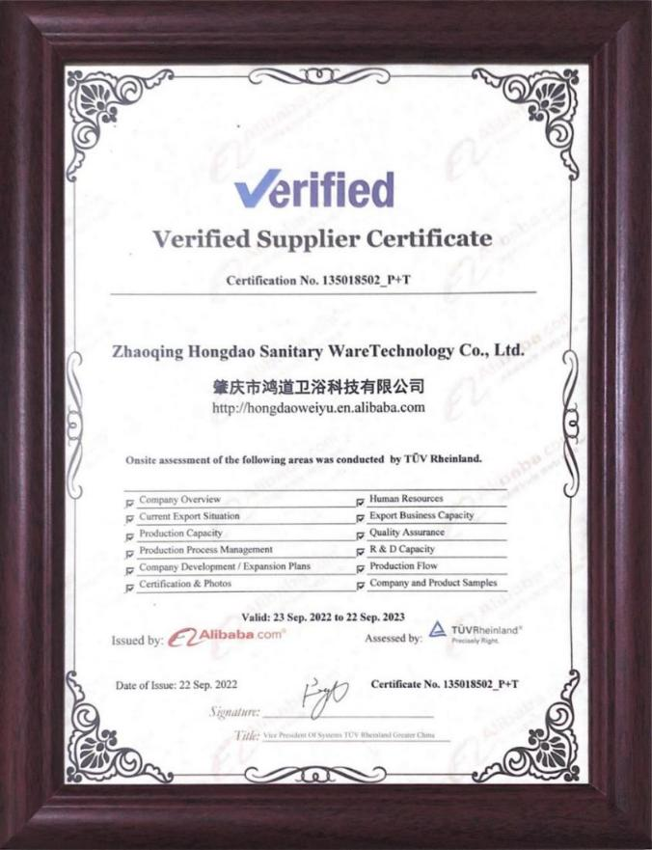
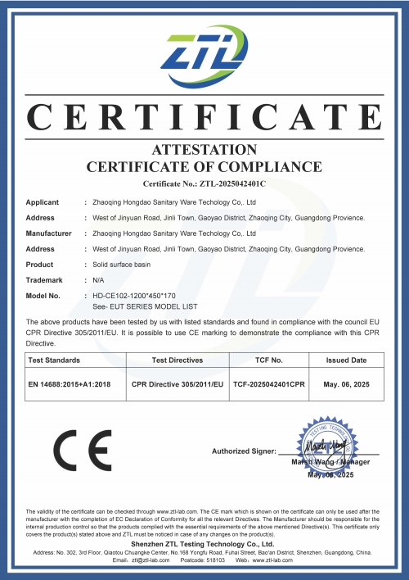
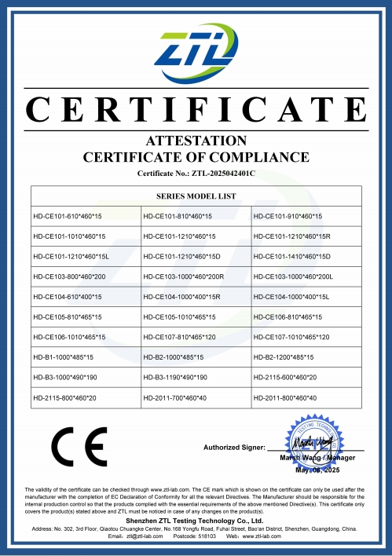
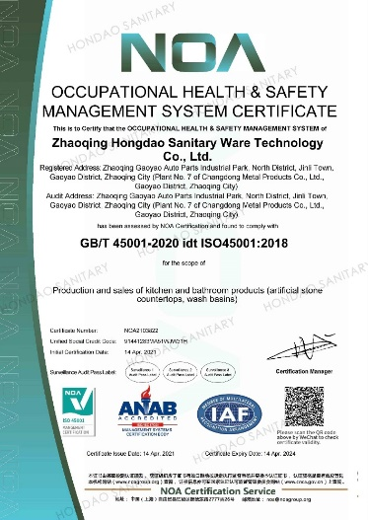
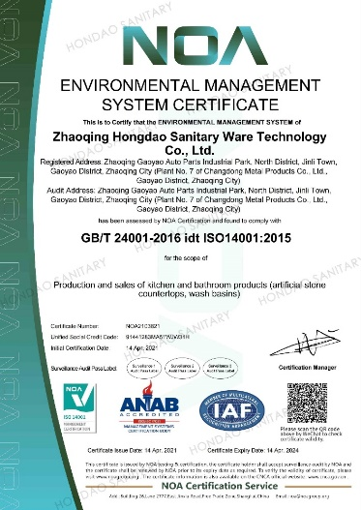
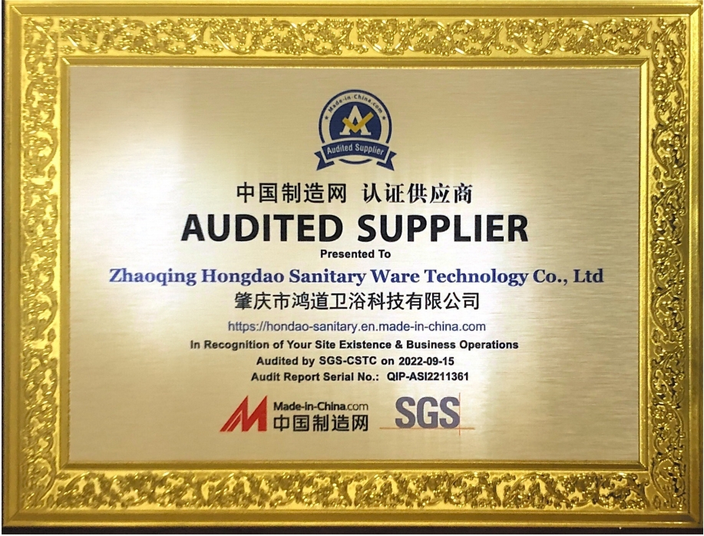
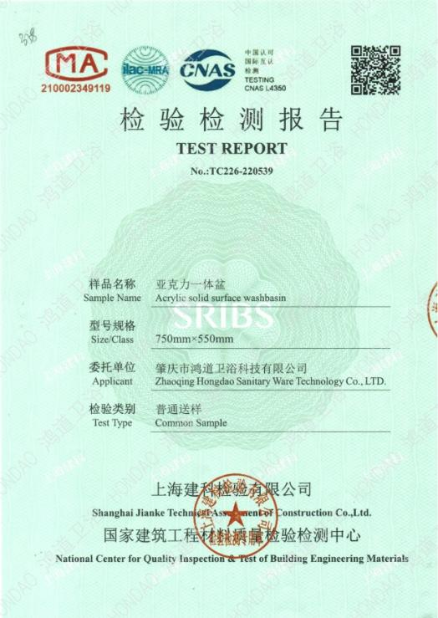
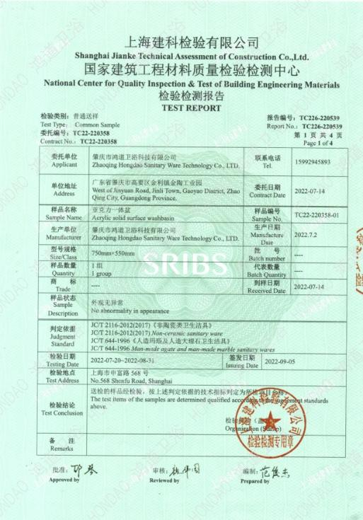
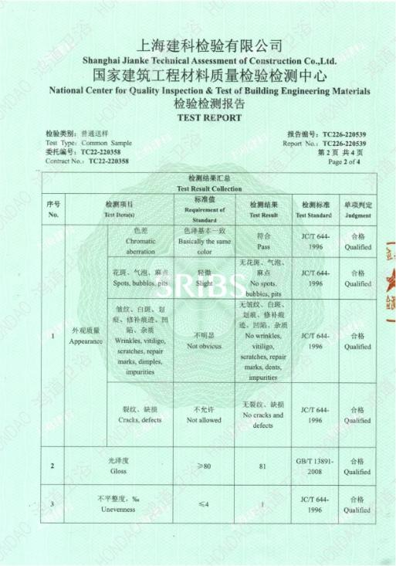
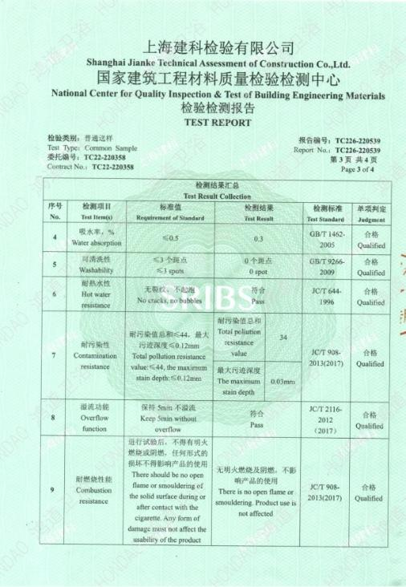
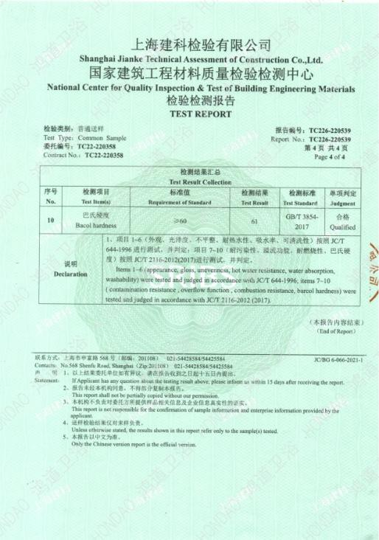
CERTIFICATES
Notes:
Earlier, we mentioned our certified quality. Now, let’s focus on the certifications themselves.
These certificates are more than just documents—they are official proof of quality.
Certifications such as cUPC, SGS, and CE confirm that our products meet internationally recognized standards.
They ensure our products deliver high hardness, stain resistance, and long-lasting durability, fully meeting the strict requirements of residential and commercial projects worldwide.
These certifications serve as a “trust armor,” allowing our clients to choose our sanitary ware with complete confidence.

Slide 7
Our Products - A Premium
Selection of Sanitary Ware
Durability, Hygiene & Elegance in Every Piece.
Notes:
Next, I would like to introduce our products.
I represent Zhaoqing Hongdao Sanitary Ware Technology, a company with 21 years of industry expertise.
Our product portfolio includes a wide range of premium sanitary ware, each combining durability, hygiene, and elegant design.
From material performance to design flexibility, our products are well suited for global residential and commercial applications.
If you are looking for high-quality sanitary ware solutions, we believe our products are worth your consideration.
Now, let me introduce our product range in more detail.

Slide 8
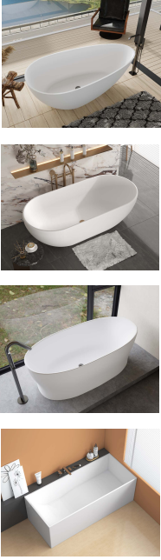
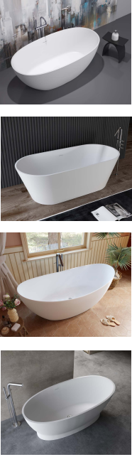
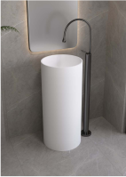
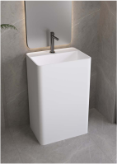
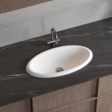
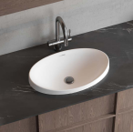
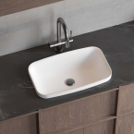
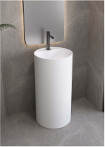
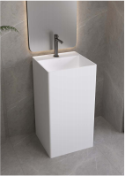
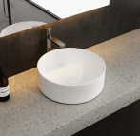
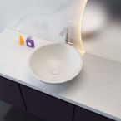
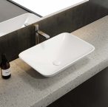
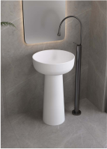
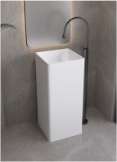
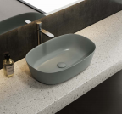
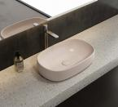
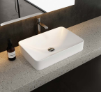
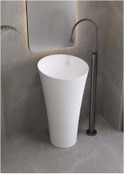
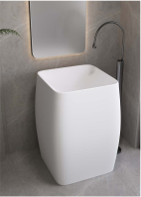
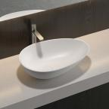
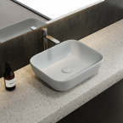
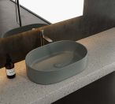
HD-YG3301
HD-YG3302
HD-LZ107
HD-LZ104
HD-TS105
HD-TS106
HD-TS107
HD-YG3303
HD-YG3304
HD-LZ102
HD-LZ105
HD-TS101
HD-TS102
HD-TS110
HD-YG3305
HD-YG3308
HD-LZ109
HD-LZ106
HD-TS109
HD-TS111
HD-TS112
HD-YG3306
HD-YG3309
HD-LZ108
HD-LZ101
HD-TS114
HD-TS103
HD-TS113
Notes:
Here you can see multiple product models, such as HD-YG3301, HD-LZ107, and others.
Each model represents our craftsmanship and expertise in sanitary ware manufacturing.
These models belong to different series, each with its own unique features and performance advantages.
Developed with 21 years of experience, every product reflects our professional strength in material selection and production technology, meeting the diverse needs of global clients and various project requirements.

Slide 9
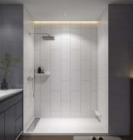
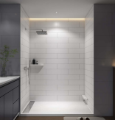
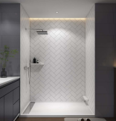
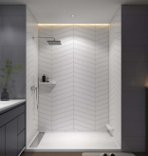
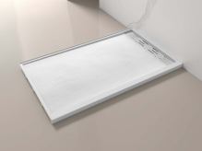
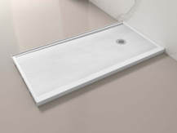
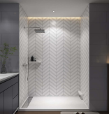

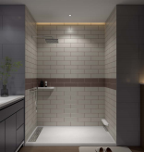
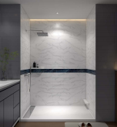
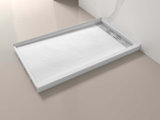
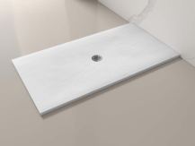
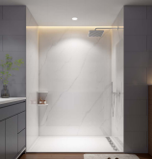
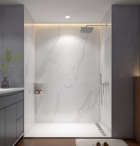








HD-SW2
HD-SW4
HD-SW5
HD-SW6
HD-STM2
HD-STM6
HD-SW7
HD-SW10
HD-SW8-1
HD-SW8-2
HD-STM7
HD-STM4
HD-SW101
HD-SW102
HD-SW103
HD-SW104
HD-STM3
HD-STM5
HD-SW108
HD-SW105
HD-SW106
HD-SW107
Notes:
Each product code represents a carefully crafted artificial stone sanitary ware item.
These products demonstrate the richness of our product line, capable of meeting diverse needs in style, size, and application.
Whether your project requires a modern minimalist look or a more classic and luxurious design, we can offer suitable solutions.
Our goal is to provide high-quality sanitary ware solutions for all types of projects.

Slide 10



























HD-CK111 | HD-CK111 | HD-CK111
HD-CK110 | HD-CK115 | HD-CK115
HD-CK103 | HD-CK112 | HD-CK112
HD-CK109 | HD-CK109 | HD-CK109
HD-CK113 | HD-CK114 | HD-CK114
A-series | S-series | B-series
D-series | F-series | M-series
HD-CK105 | HD-CK101 | H-series
HD-CK116 | HD-CK117 | HD-CK118
Notes:
After reviewing multiple models, I would like to highlight one featured product:
HD-CK111 A-Series.
This is one of the most distinctive products in our lineup, maintaining our consistent standards of durability, hygiene, and quality.
If you are interested in this model, our team will be happy to provide further details.
Now, let me explain its key advantages in more detail.

Slide 11
Project case
- Partners Working with Us
Our Partners, Our Strength
Notes:
Successful projects are never achieved alone—they rely on strong partnerships.
By working closely with our partners, we integrate resources, complement each other’s strengths, and drive innovation together.
Next, I will introduce several projects we have completed with our partners, allowing you to clearly see the value of cooperation.

Slide 12







Project with Ji Hotel: Custom Stone Basin Supply
Notes:
Now let’s move into our project cases.
One important project is our cooperation with J Hotel, where we supplied customized stone basins.
This project demonstrates our strong capability in custom product solutions and our ability to meet specific client requirements.
Let me briefly walk you through this project.

Slide 13







Slide 14







Project with Wanda Moments Hotel: Solid Surface Vanity Supply
Notes:
We cooperated with Wanda Meihua Hotel, supplying solid surface vanity tops.
As a well-known hotel brand, Wanda Meihua’s choice reflects strong recognition of our product quality and manufacturing capability.
Solid surface vanity tops offer durability, aesthetics, and customization, perfectly meeting hotel design and performance requirements.
This cooperation further expanded our presence in the hotel project sector.

Slide 15








Project with Lavande Hotel: Premium Stone Basin Supply
Notes:
Next is our cooperation with Ji Hotel, where we supplied premium stone wash basins.
These basins combine refined design with excellent performance, meeting the hotel’s high standards.
This project once again demonstrates our reliability as a hotel sanitary ware supplier.

Slide 16







Project with Home Inn Hotel: Artificial Stone Sink Supply
Notes:
We also cooperated with Home Inn, supplying artificial stone sinks.
As a well-known hotel chain, Home Inn values durability and consistency.
Artificial stone sinks provide both practicality and aesthetic value, enhancing the overall quality of hotel bathrooms.
This partnership reflects strong market recognition of our products.

Slide 17










Project with Holiday Inn Express-Temecula: Custom Stone Sink Supply
Notes:
Next, I would like to introduce our cooperation with Holiday Inn Express – Temecula.
We provided customized stone sinks, designed specifically to meet the hotel’s unique requirements.
Through professional customization, we helped enhance both functionality and overall project quality.

Slide 18








Project with Holiday Inn Express-Kingman: Shower Base & Wall Panel Supply
Notes:
We also partnered with Holiday Inn Express – Kingman, supplying shower bases and wall panels.
This project highlights our diverse product supply capability and professional project support across different bathroom areas.

Slide 19






Project with Town Place Suites: Artificial Stone Shower Wall Supply
Notes:
Here we see our cooperation with TownePlace Suites, where we supplied artificial stone shower walls.
This project demonstrates our flexibility and expertise in bathroom wall solutions for hotel projects.

Slide 20








Cooperative Partner
Notes:
We have established partnerships with many hotel brands worldwide.
From supplying artificial stone sinks to Home Inn, to customized sinks, shower bases, and wall panels for Holiday Inn hotels, and shower walls for TownePlace Suites—each project reflects our reliability and reputation.
Our partners’ trust motivates us to continue growing and building long-term cooperation.

Slide 21






Exhibition partners
Notes:
After reviewing our partners, let us now turn to our exhibition collaborations.
Exhibition partners help us present our products to a wider audience and support future cooperation.
Next, we will continue with factory presentation and future collaboration opportunities.

Slide 22
Partnership for a Shared Future.
Factory Showcase​ - Two Advanced Production Lines
Explore high-definition visuals of our product details and professional production lines.
Notes:
Now, I would like to introduce our factory and production capability.
All of these successful projects are built on our strong manufacturing foundation.
Today, I invite you to step into our factory, guided by the vision of “Partnership for a Shared Future.”
With two advanced production lines, you can explore product details and professional manufacturing processes through high-definition visuals.
Let’s begin this factory tour together.

Slide 23






Zhaoqing Factory
Notes:
Our Zhaoqing factory is one of our key production bases.
With a strong industrial environment and excellent logistics conditions, it ensures efficient production and stable supply.
Here, advanced equipment and skilled craftsmanship work together to deliver consistent, high-quality products.

Slide 24





Jiangxi Factory
Notes:
Next, I would like to introduce our Jiangxi factory, another core manufacturing base.
A visit to the Jiangxi factory allows you to clearly see our advanced technology and strict quality control.
Now, let’s take a closer look inside this facility.

Slide 25

We Invite You to Experience HONDAO
Visit our factory and showroom to see and feel the difference.
HONGDAO SANITARY WARE TECHNOLOGY CO.LTD
Tel: +86-758-8596680
Email:​ linda@gdhondao.com
Web：www.hondaowashbasin.com
Add：West of Jinyuan Road, Jinli Town, Gaoyao District, Zhaoqing City, Guangdong Provience

